Slide 1
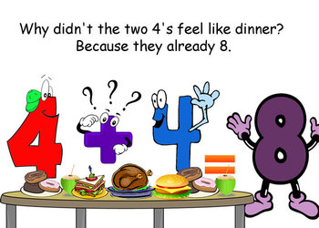
Number
Term 1
Semester 1
Teacher:
Class:

Slide 2
Contents
Glossary or Formula Page
Page
Date
Description
2
3

Slide 3
Tasks
24
7
30
Essential Question
Questions
Notes
Summary
4
5

Slide 4
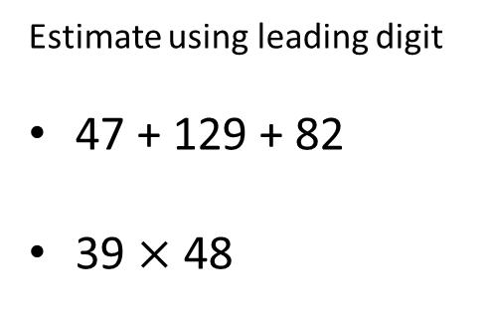
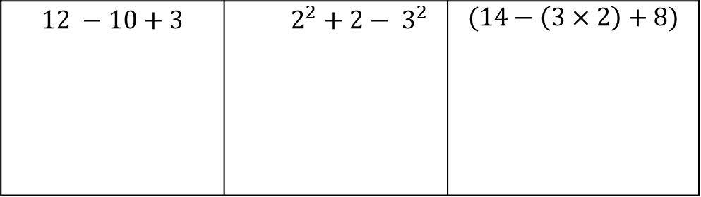
24
7
30
Topic: ESTIMATING & ROUNDING
Date
Essential Question:
How do we estimate and round whole numbers and decimals?
Questions
Notes:
Example :
REVISION QUESTIONS
$$12 −10+3$$ | $$2^{2}+2− 3^{2}$$ | $$(14−\left(3×2\right)+8)$$
Estimate using leading digit
47 + 129 + 82
39 $×$ 48
5

Slide 5
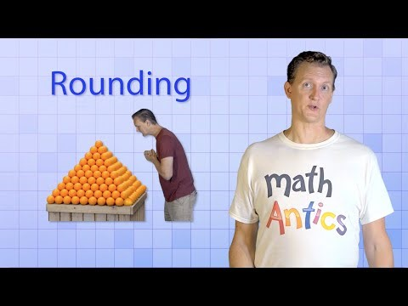

Slide 6
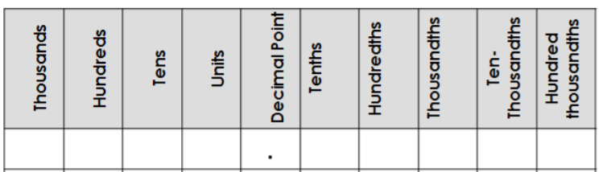
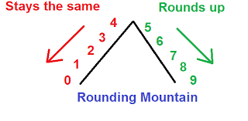
24
7
30
Topic: ESTIMATING & ROUNDING
Date
Essential Question:
How do we estimate and round whole numbers and decimals?
Questions
Notes:
What is rounding?
8 0 2 1 4 5 7
Whole number
Tenth
Hundredth
5

Slide 7
YOUR TURN - LHS
 | 1 decimal place | 2 decimal places
16.1256
29.7681
104.554
124.727
1972.989

Slide 8
YOUR TURN - LHS
 | 1 decimal place | 2 decimal places
16.1256 | 16.1 | 16.13
29.7681 | 29.8 | 29.77
104.554 | 104.6 | 104.56
124.727 | 124.7 | 124.73
1972.989 | 1973.0 | 1972.99

Slide 9
Exercise 1.07 – page 21
Questions: 5, 6, 8, 9,
11, 12, 13,
15, 17, 18
Finished? …. Try question 19

Slide 10
